Slide 1
IF3141
SISTEM INFORMASI
Implementation and Changeover
Semester I 2024/2025
IF3141 | TEKNIK INFORMATIKA ITB

Slide 2
Implementation in the Lifecycle
The purpose of the implementation stage is to make a new system operational. This is achieved through the transfer of the tested software modules to the operational or ‘live’ environment, along with setting up of the data required for the new system.
Implementation is carried out after the solution has been fully tested, accepted, and signed off by the sponsor.

Slide 3
Planning for Implementation and Changeover
Planning for implementation and changeover should begin as early as possible in the systems development lifecycle so that issues, timings, training, resources and so on can be considered and planned for. Failure to carry out a successful implementation can have severe consequences for the organization.
Implementation planning is an important responsibility of the project manager. In order to determine all of the relevant factors, input will be needed from key stakeholders, including:
Service manager: understanding possible impact on service level
Users: for determining training needs and delivery, business and financial implications, etc
Sponsor: for agreeing any business risks and impacts
Business analysts: validation of business data and processes
Technical specialists: the best method for file and data conversion

Slide 4
Planning for Implementation and Changeover
Some of the planning considerations include:
How to set up data in the new system
Which software modules should be migrated from the test environments to the operational environments, and when?
What checks are needed to confirm that the migration has been successful?
Exactly when will the implementation occur?
How long will the implementation take?
What documentation will be needed to manage and operate the new system?
What new skills and training will the users and operators of the new system need and what is the best mechanism for delivering this training?
What is the best way of changing over to the new system from the old system?

Slide 5
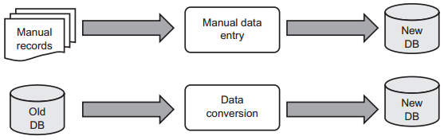
File and Data Conversion or Creation
Implementing a new system will inevitably require new data. If the system is entirely new, then data will need to be created manually or from paper records such as existing invoices or customer orders
Nowadays, most implementations are an upgrade to, or replacement of, an existing system. The existing data will need to be converted to the new format, and a data mapping exercise is needed to determine how best to convert the old data to the new and to identify potential issues.

Slide 6
File and Data Conversion or Creation
The process for converting data from an old system to a new system can be automated, via bespoke software or a commercial off-the-shelf package (COTS). This is called ETL (Extract, Transform and Load), signifying the following steps in the conversion process:
1. Extract of data from the old system;
2. Carrying out some form of transformation of the extracted data making it suitable for the new system; and
3. Load of the transformed data into the new system.
Sometimes the costs involved in developing bespoke ETL software or purchasing a COTS may be excessive or might not be possible within time constraints. In this case, it may be quicker and easier to re-key data into the new system.

Slide 7
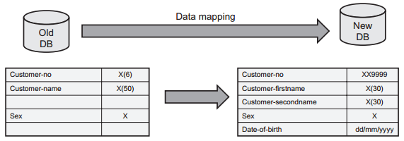
Principles and Problems of Data Mapping
Data mapping is the term given to the activity that identifies which data from the old system can be migrated to the new system

Slide 8
Principles and Problems of Data Mapping
A number of issues can arise when carrying out this mapping, including:
Field type: ex, a product number in the old system might be held as an alphanumeric field whereas in the new system, a product number is held as numeric only.
Field length: if the field in the new system is shorter than in the old system, then a business decision needs to be made as to whether truncated data is acceptable
Field structures: ex, a customer address in the old system may be held as a single address field, but on the new system it may be held as three address fields.
Required fields: some data required for the new system may not be available from the old system.
Semantics: ex, when mapping the data for ‘Title’, in the old system this may include Mister, Miss, Ms, Doctor, Sir, Lord, Mister, Miss, etc. but in the new system ‘Title’ may mean a formal title only
Validation: the conversion routines may include some tests to validate that the data on the new system has been converted correctly.

Slide 9
Planning, Testing, and Performing Data Conversion
Data conversion, like any other activity or project, is likely to be more successful if it is well planned.
The planning activities should include:
Identify steps required for the conversion
Decide timing of when the data conversion should actually take place
Writing or purchasing the conversion routines
Using automated test comparator to compare the new data with the old data and to test the conversion routines
Actual file conversion

Slide 10
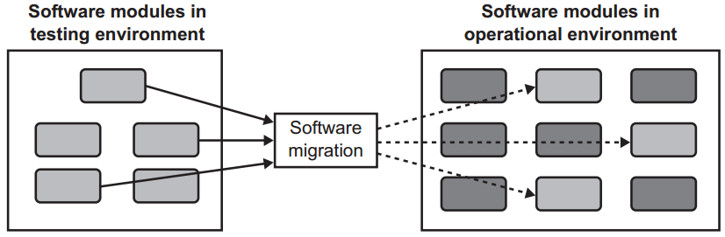
Migration of Software Modules
As well as carrying out data migration, any new or changed software modules will also need to be migrated from the test environments to the operational environment
Failure to migrate the correct modules and, perhaps more importantly, the correct versions of the software modules, could result in system failure, which in turn can cause loss of business operations.

Slide 11
Migration of Software Modules
Some key considerations for software migration include:
Configuration management
This is needed to ensure that only the correct versions of software modules which are relevant to the implementation are selected for migration.
Release management
This activity checks that only compatible implementations are packaged together, and transferred to the operational environment in a single migration.
Timing
Sometimes it can be useful to migrate the software modules in a de-activated state, such that there is no disruption to business continuity, and to activate them only when needed.
Validation
Validating that the migrated software works correctly can be carried out in stages

Slide 12
Installation of Hardware and Infrastructure
Quite often, hardware and infrastructure components will need to be installed in the operational environment as a prerequisite to the migration of data and software. For example, the volume of data, the number of users, and the rate of user activity required for a new system might necessitate larger data storage devices, increased processing capability and larger network capacity.
Upgrades to, or replacement of, the existing hardware and infrastructure will need to be managed, planned, and tested just like any other IT project. Any planning and preparation for the implementation would need to include hardware and infrastructure requirements.
Sometimes, hardware and infrastructure changes are stand-alone projects in their own right as a precursor for implementation of business activity, for example, the roll-out of desktop computers, telephones and headsets to a new call center.

Slide 13
The Role of Supporting Documentation
The users will need documentation to help them carry out their daily jobs and to provide some initial help in case of problems with using the new system.
Operations staff need documentation that helps them to support the new system, not only in terms of operating and routine maintenance, but also when unexpected problems or failures occur.
The main types of documentation for users include:
Online help, printed user guides, operational manuals, and technical documentation
Having ready access to the correct documentation becomes a vital aspect of supporting new systems, and many organizations have at times encountered situations where operational problems have taken some considerable time to resolve due to lack of up-to-date documentation.

Slide 14
Approaches to Training
In addition to having documentation to support their day-to-day activities, users and operations staff will likely need to be trained in the new system. There are various approaches to training, but the main elements to consider include:
Identify competencies
The new system will have some new or changed business processes and operational procedures, which in turn will require new or changed competencies and skills to carry them out.
Define training strategy
Compare the competencies need to the competencies that the users and operational staff already possess (training need analysis).
Deliver training
Consideration: impact, how much, complexity, skill

Slide 15
Approaches to Training
The main methods of delivering training include:
Traditional lectures and workshops
Face-to-face training to the potential users of the system by someone who understands the new features really well.
Remotely delivered training
Remotely delivered training consists of, for example, webcasts and teleconferencing, whereby the trainer and trainees are brought together via technology, for relatively short periods of time.
Train the trainer
A small group of ‘super-users’ are trained in the new system, perhaps to a higher standard and level of expertise, and these ‘superusers’ then train the rest of the user community and or provide centres of excellence and support.

Slide 16
System Implementation
An important consideration when planning for implementation is how to switch over, or ‘changeover’, to the new system from the old, that is, for deploying the new system into operation.
There are four main options for changeover:
Direct changeover or ‘big bang’
Parallel running
Pilot implementation
Phased implementation

Slide 17
Direct Changeover or ‘Big Bang’
The new system is brought straight into operation, and the old system (or manual system, if there isn’t a previous system in place) is switched off. This direct changeover, or ‘big bang’, means that there is an immediate switch to using the new system and business processes without any gradual transition to the new system.
Advantages
There’s a ‘clean break’ from the old system to new system
Users are forced to start using the new system straight away
Less expensive
Disadvantages
High risk – there is no fall back in the situation
There may be reputational damage to organisation

Slide 18
Parallel Running
With this option, the old and new systems are both operated side by side until the organization is confident that the new system is operating satisfactorily, and at this point the old system is switched off.
Advantages
Less risk than direct changeover approach
In the event that the new system fails or is unsatisfactory, the old system is a fallback.
Users can gradually transition from the old to the new system.
Data from the new system can be compared with data from the old system to validate the correct functioning of the new system.
Disadvantages
More expensive than direct changeover approach
Users may be reluctant to move to the new system

Slide 19
Pilot Implementation
A pilot implementation is where the new system is initially implemented in one or more sites, or with a subset of users, rather than being implemented across the whole organization.
Advantages
Less risk than direct changeover approach
New system is only deployed to the organization as a whole when it is more stable and major problems have been eliminated
Operational use during pilot enables new system to be ‘tuned’ to be more effective
Less costly to implement the new system and resolve any errors in pilot
Disadvantages
The area chosen for pilot might not be typical of the users and sites as a whole
If the experience of users during pilot is poor, it might undermine confidence in new system

Slide 20
Phased Implementation
The functionality of the new system is deployed in stages or increments such that, in the first phase, a subset of the total functionality of the new system is deployed, and then additional components and functionality are deployed in successive stages until the new system is fully operational.
Advantages
Higher priority requirements and functionality can be delivered sooner
The risk is reduced
Users can gradually transition from the old to the new system in stages, and gain confidence
It is easier to fall back to earlier phases if problems are encountered with later phases
Disadvantages
Users might lose interest after their higher priority reqs are delivered in initial phases
Users might not adopt earlier phases if they are mainly interested in features being delivered in later phases
Can be expensive
Users might cling on to the old systems and ways of working

Slide 21
The Implementation Plan
The implementation plan is a key document in the system development lifecycle and is used by everyone involved in the implementation activity to ensure that all of the steps are detailed, understood and feasible.
It also states what actions should be followed to validate that the implementation is being carried out successfully, and what actions and escalations should be triggered in the event of problems or issues.

Slide 22
The Implementation Plan
A typical implementation plan includes:
Author and sign-offs
Revision history
Purpose
System overview
Stakeholders
Points of contact
Implementation schedule
Entry criteria
Exit criteria

